Slide 1

FSK Modulator
Group Members:-
Shreyas Talokar - 612207092
Suraj Shewale - 612207077
Tanmay Raut - 612207070

Slide 2
AIM:-
To Design FSK Modulator using IC 555

Slide 3
Objectives:-
Develop a Frequency Shift Keying (FSK) modulator circuit using IC555 to efficiently shift between two frequencies corresponding to binary 0 &1.
Investigate and optimize the operational configuration of the IC555 for FSK modulation, considering all parameters.
To analyze the advantages and disadvantages of FSK Modulation.
To Explore the Mathematical Foundation of FSK.
To Summarize the Significance of FSK Modulation.

Slide 4
MATERIAL REQUIRED:-
Sr. No. | Material | Quantity
1. | IC 555 | 2
2. | PNP TRANSISTORS | 1
3. | RESISTORS | 2
4. | POTENTIOMETER | 2
5. | CAPACITORS | 4

Slide 5
FSK (Frequency Shift keying)
FSK is the digital modulation technique in which the frequency of the carrier signal varies according to the digital signal changes.
FSK is a scheme of frequency modulation. The output of a FSK modulated wave is high in frequency for a binary High input and is low in frequency for a binary Low input.
The binary 1s and 0s are called Mark and Space frequencies.

Slide 6
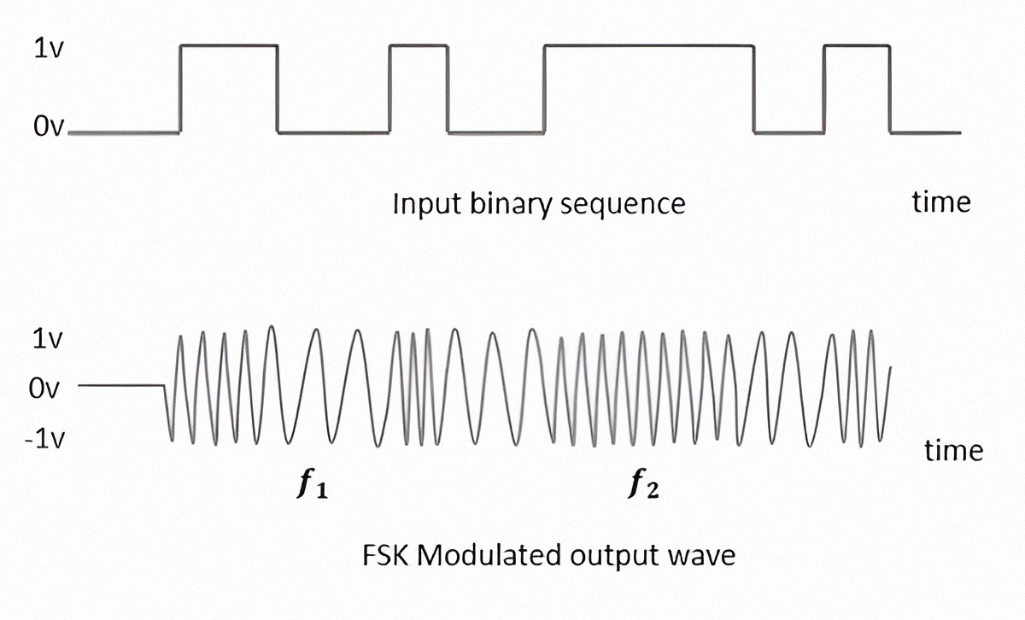
FSK waves:-

Slide 7
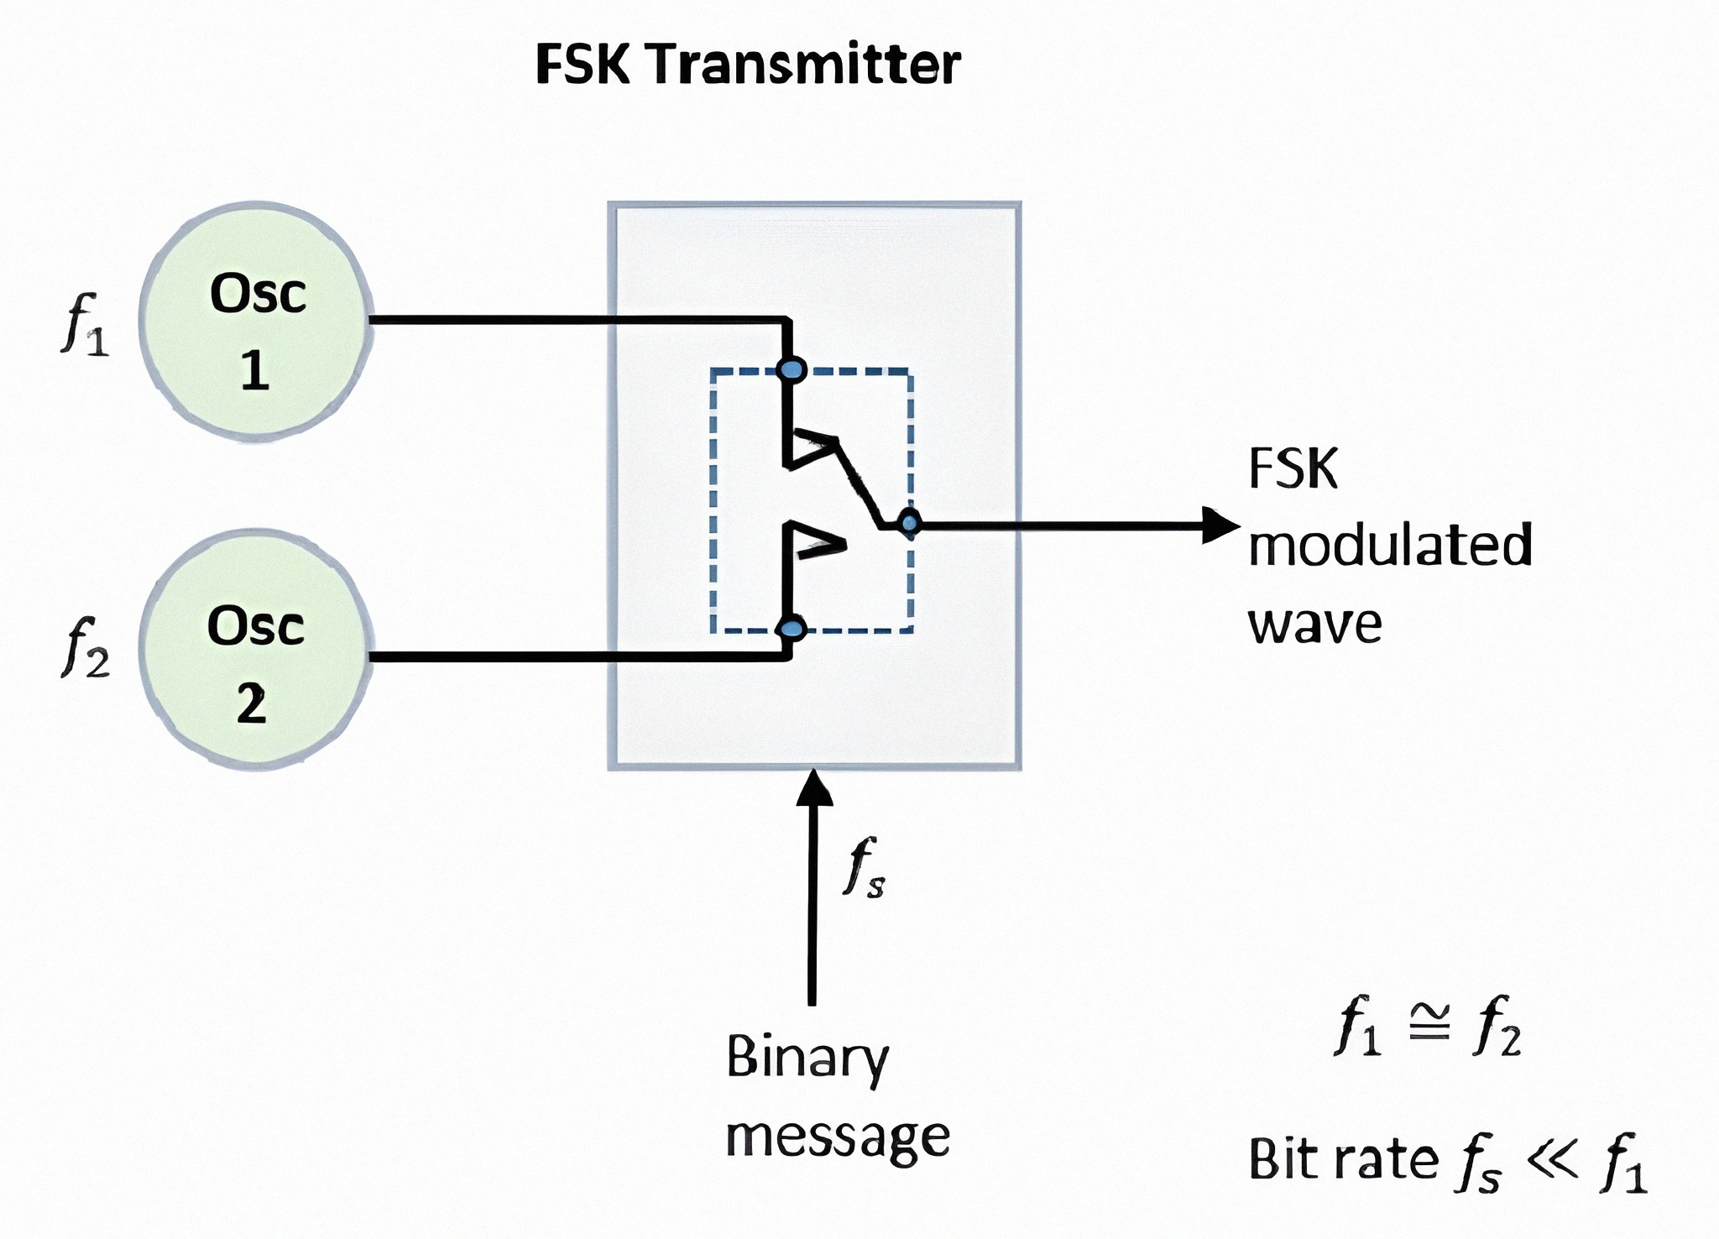
FSK modulator:-
The FSK modulator block diagram comprises of two oscillators with a clock and the input binary sequence. Following is its block diagram.

Slide 8
The two oscillators, producing a higher and a lower frequency signals, are connected to a switch along with an internal clock.
To avoid the abrupt phase discontinuities of the output waveform during the transmission of the message, a clock is applied to both the oscillators, internally.
The binary input sequence is applied to the transmitter so as to choose the frequencies according to the binary input.

Slide 9
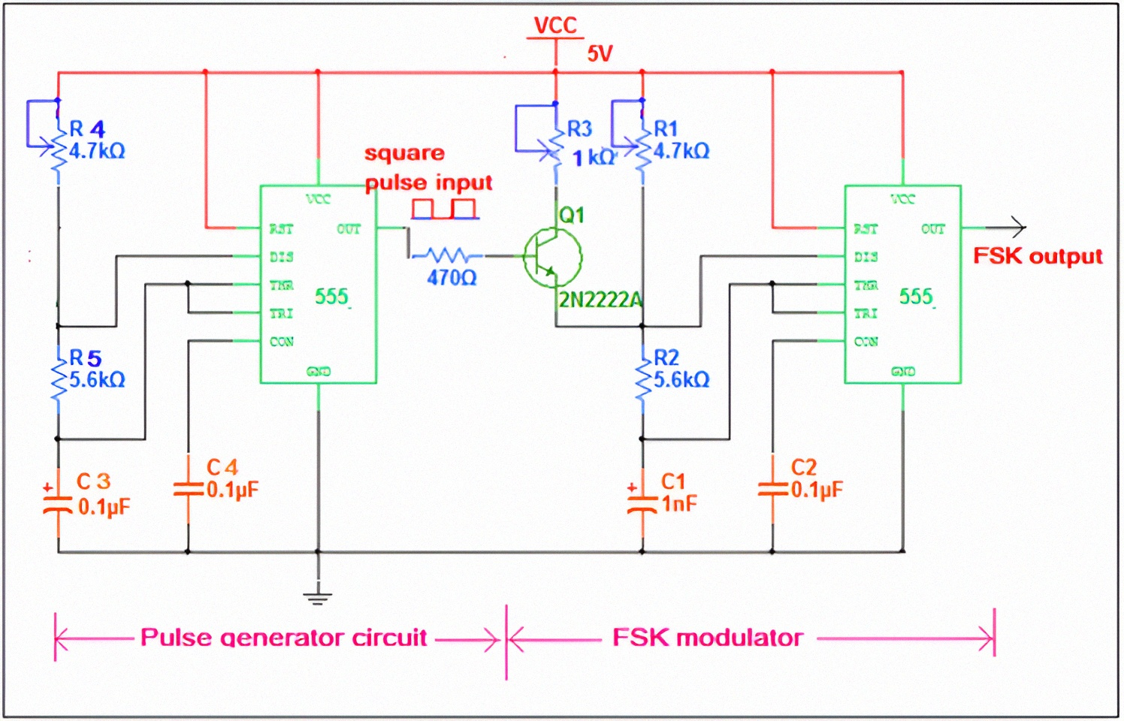
FSK modulator Circuit diagram:-

Slide 10
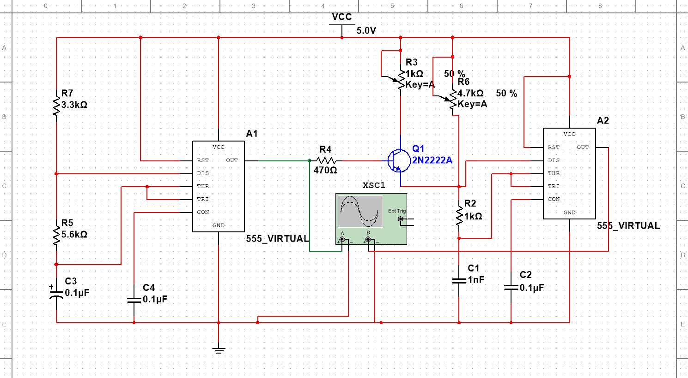
FSK modulator SIMULATION :-

Slide 11
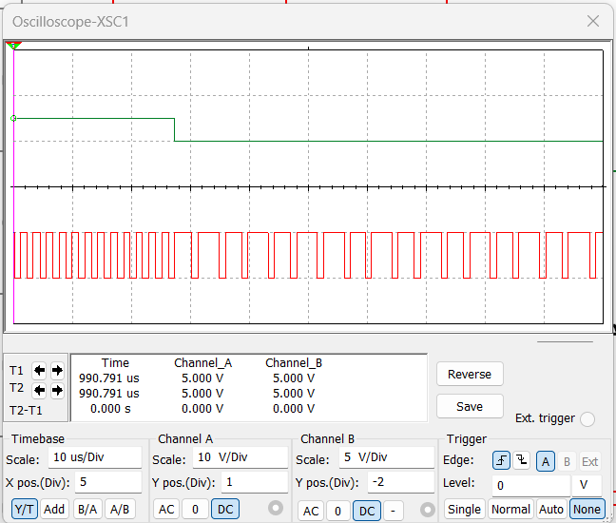
FSK modulator SIMULATION OUTPUT :-

Slide 12
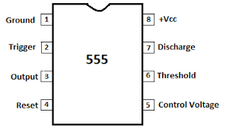
Functions OF COMPONENTS USED:-
IC 555 Pin Functions:-
Pin 1 :- Ground, Connects to the 0V Power Supply
Pin 2 :- Trigger, Determines the threshold at which the output switches state; when voltage falls below one-third of Vcc, it triggers the IC.
Pin 3 :- Output, Provides the output signal of the IC, which switches between high and low states based on internal timing.
Pin 4 :- Reset, When a low voltage is applied to this pin, it resets the timing cycle of the IC, typically connected to Vcc for normal operation.

Slide 13
Functions OF COMPONENTS USED:-
IC 555 Pin Functions:-
Pin 5 :- Control Voltage, Allows external voltage control over the threshold and trigger levels, affecting the timing characteristics of the IC.
Pin 6 :- Threshold, Sets the voltage level at which the output switches state; when voltage exceeds two-thirds of Vcc, it triggers the IC.
Pin 7 :- Discharge, Used to discharge the timing capacitor to ground during the timing cycle, ensuring proper timing operation.
Pin 8 :- +Vcc, Connected to the positive power supply.

Slide 14
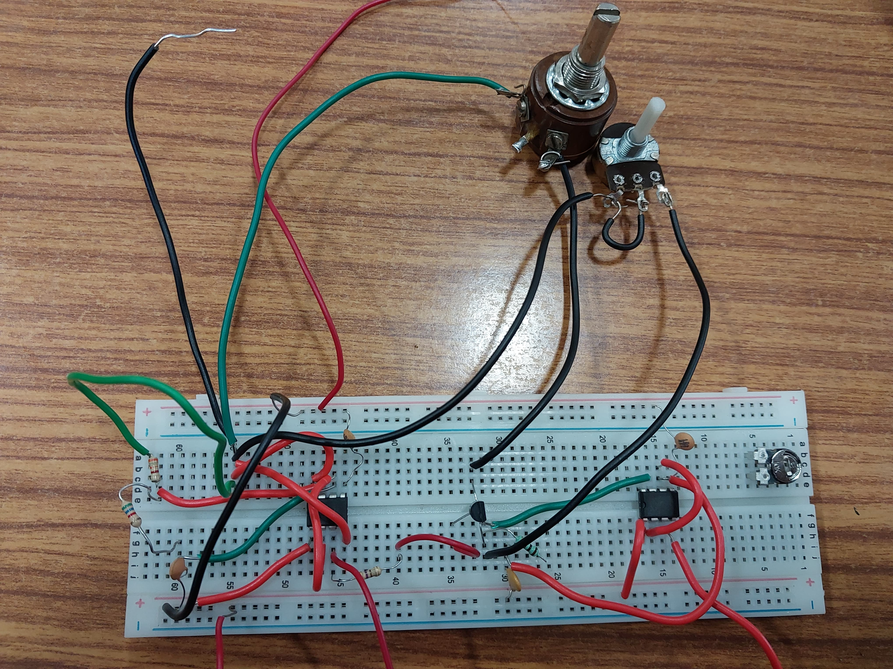
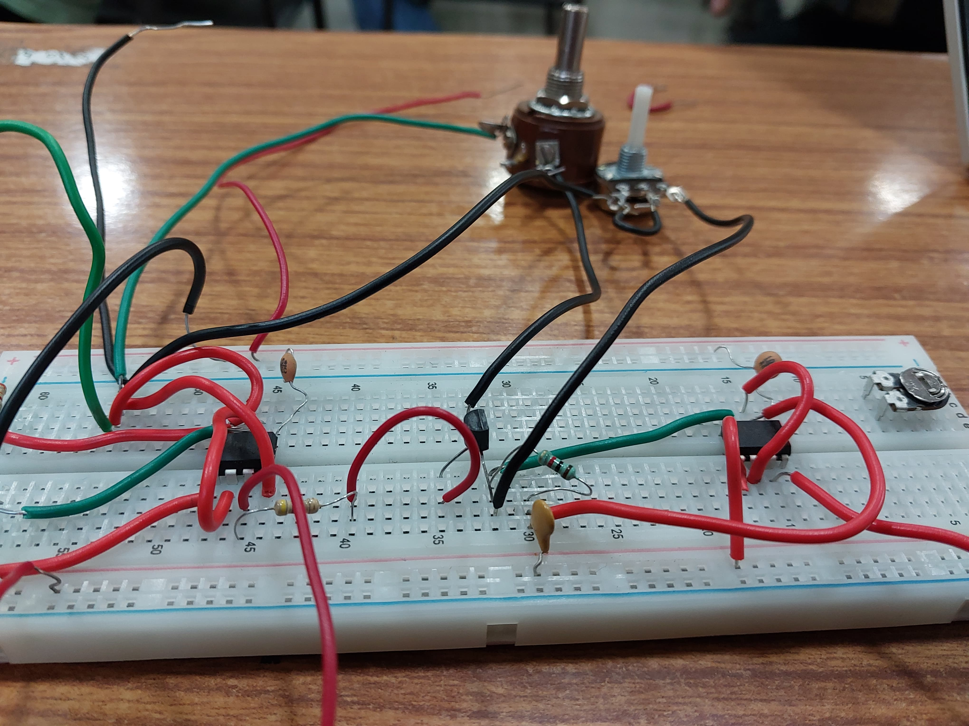
HARDWARE CIRCUIT :-

Slide 15
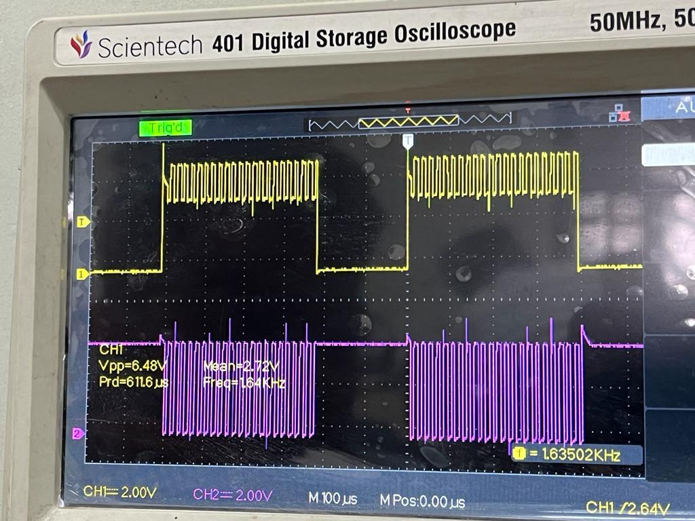
output :-

Slide 16
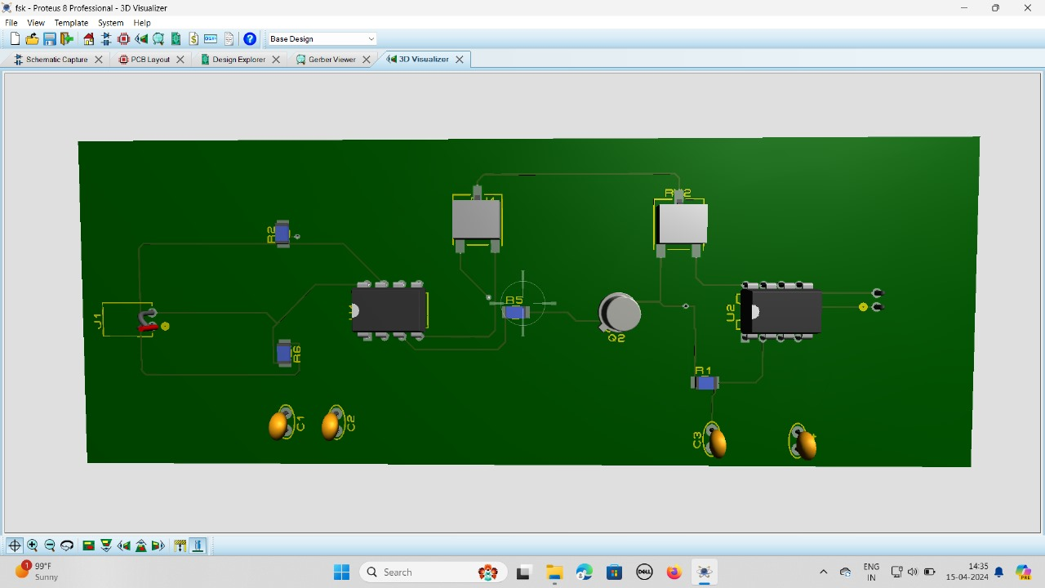
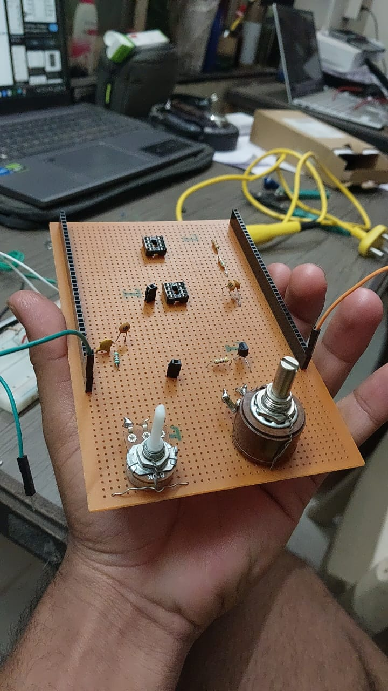
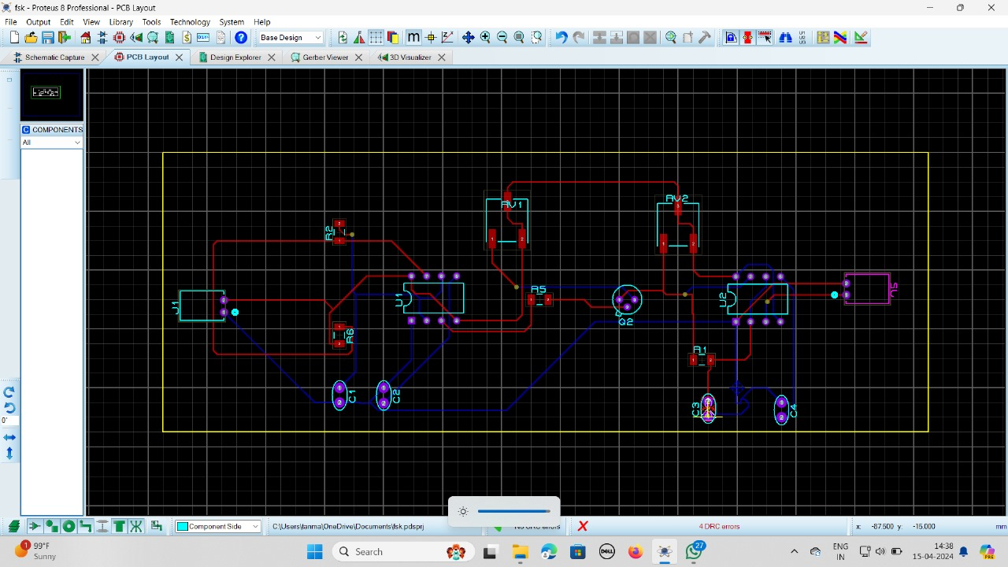
PCB DESIGN AND HARDWARE :-

Slide 17
Applications :-
It is used Point to point military communication and telephone modems.
The technology is used for communication systems such as amateur radio, caller ID and emergency broadcasts. Thus ,in project frequency shift keying using ic 555 is achieved.
It having two frequency such as mark frequency(1008HZ) and space frequency(1218HZ).
Frequency shift keying is better than amplitude shift keying as it have a better noise immunity.

Slide 18
References :-
https://www.engineersgarage.com/fsk-modulators-using-ic-555/
https://www.electronicsforu.com/technology-trends/learn-electronics/555-timer-working-specifications

Slide 19
Thank You

